Slide 1
Pytorch Introduction

Slide 2

Definition
PyTorch is an open source machine learning (ML) framework based on the Python programming language and the Torch library. It can be used to train neural networks and one of the preferred platforms for deep learning. It supports over 20 different mathematical operations.

Slide 3
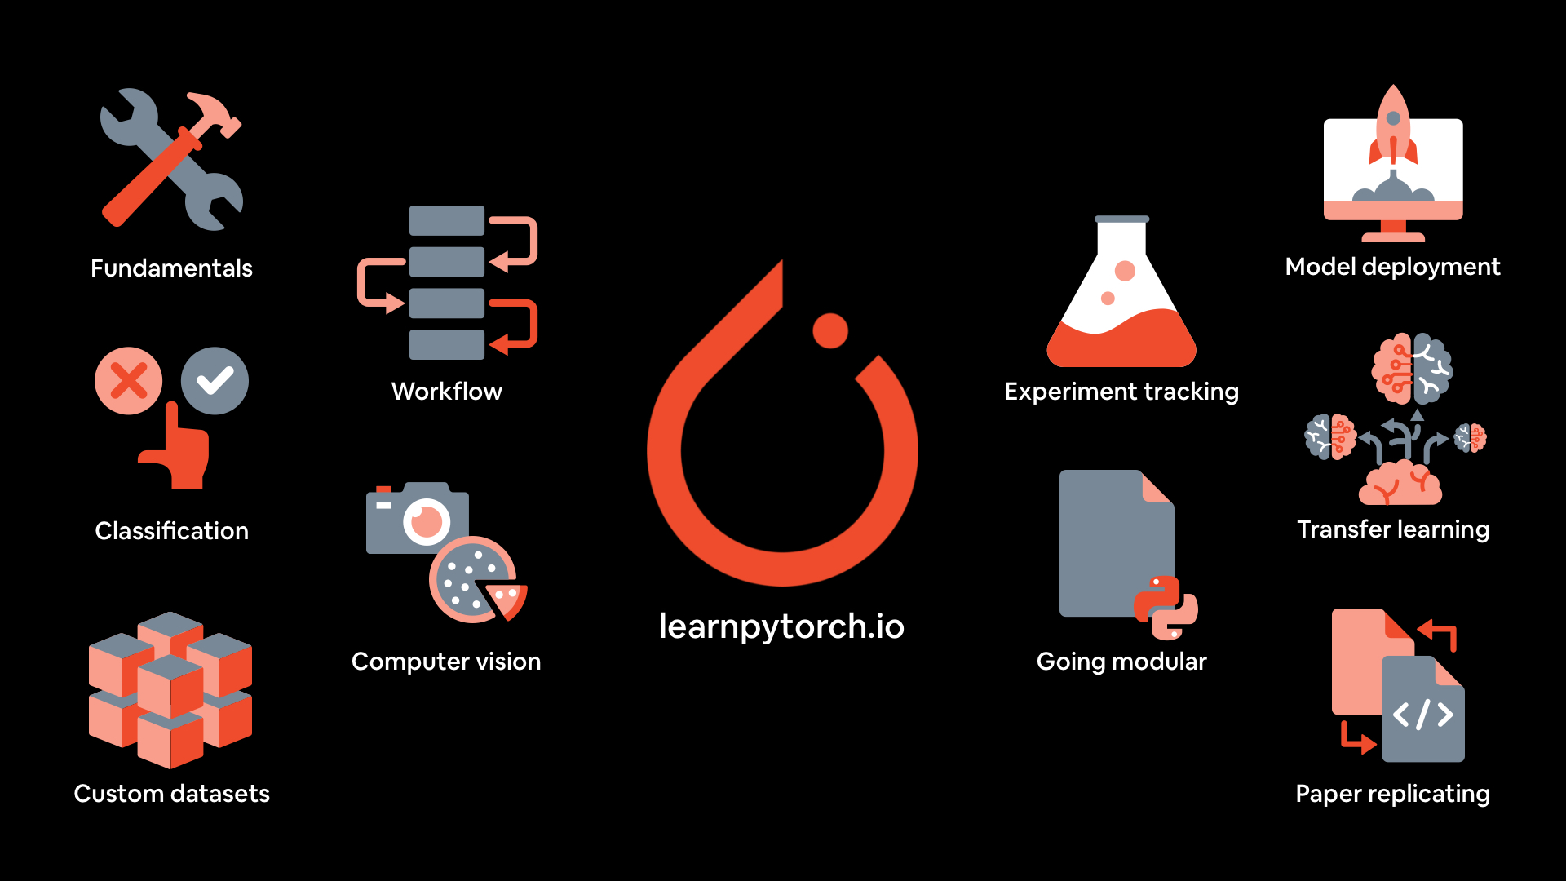
2. Features of Pytorch
Tensor computation: Pytorch provides supports for tensor (n-dimensional arrays) computation like Numpy with GPU acceleration
Training deep neural networks

Slide 4
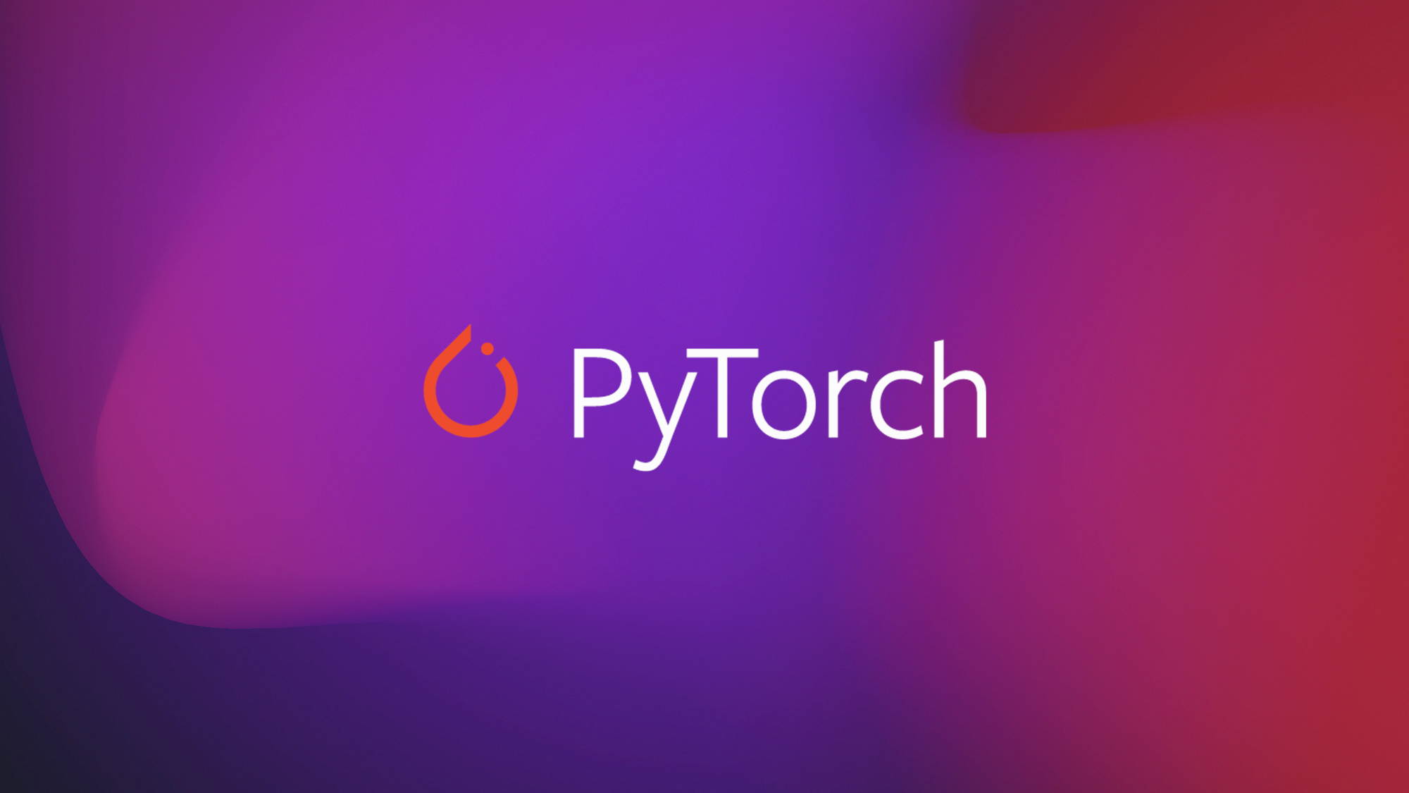
3. Advantages of Pytorch
Beginner-friendly, easy-to-learn code structure that is based on Pytorch
User-friendly interface
Offers scalability and is well-supported on major cloud platforms
Offers easy debugging with Python tools

Slide 5
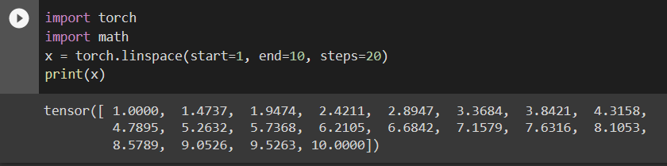
4. Basic functions
Torch.linspace: torch.linspace is used to create a 1D equally spaced tensor between the values start and end, with the is number of values .

Slide 6
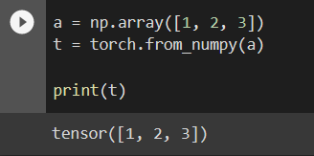
4. Basic functions
Torch.from_numpy: Creates a Tensor from a numpy.ndarray.

Slide 7
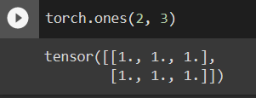
4. Basic functions
Torch.ones: Returns a tensor filled with the scalar value 1 , with the shape defined by the variable argument size.
Torch.zeros: Returns a tensor filled with the scalar value 0, with the shape defined by the variable argument size.
Similar to np.ones or zeros

Slide 8
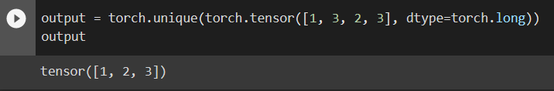
4. Basic functions
Torch.unique: Returns the unique elements of the input tensor.

Slide 9

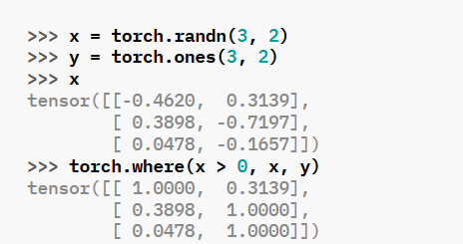
4. Basic functions
Torch.where: Return a tensor of elements selected from either x or y, depending on condition.

